Slide 1
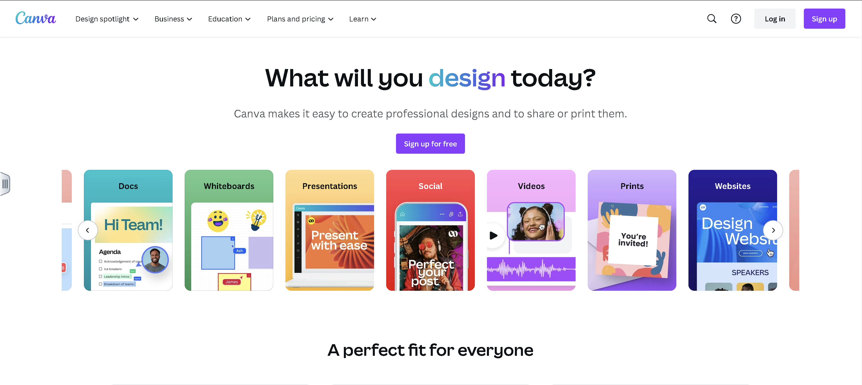
Login or sign up for a Canva account
Design a business card using Canva

Slide 2
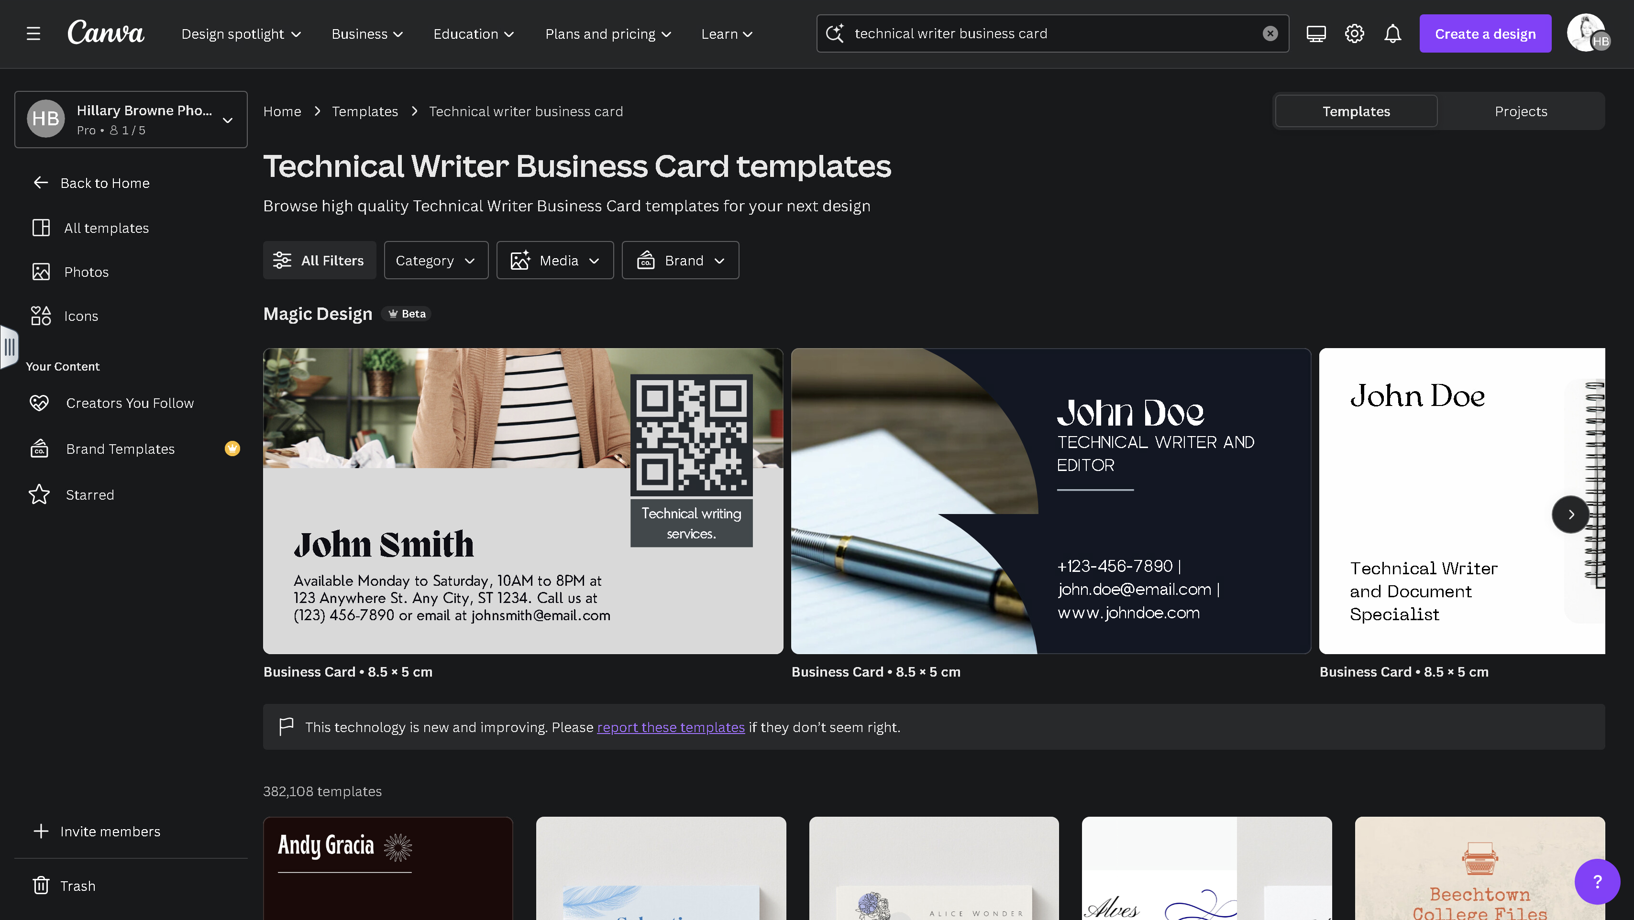
Start typing project keywords in the search bar to generate a specific template

Slide 3
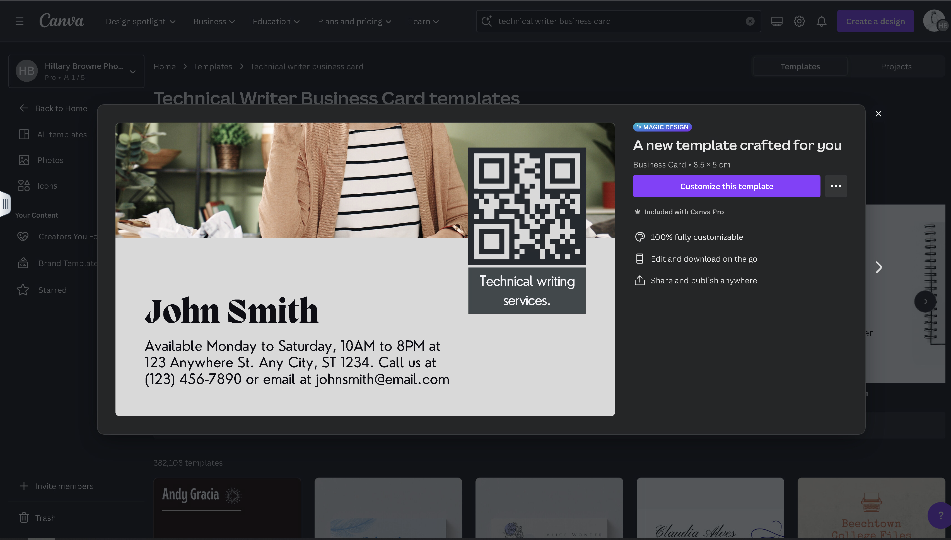
Click the purple button to select a template

Slide 4
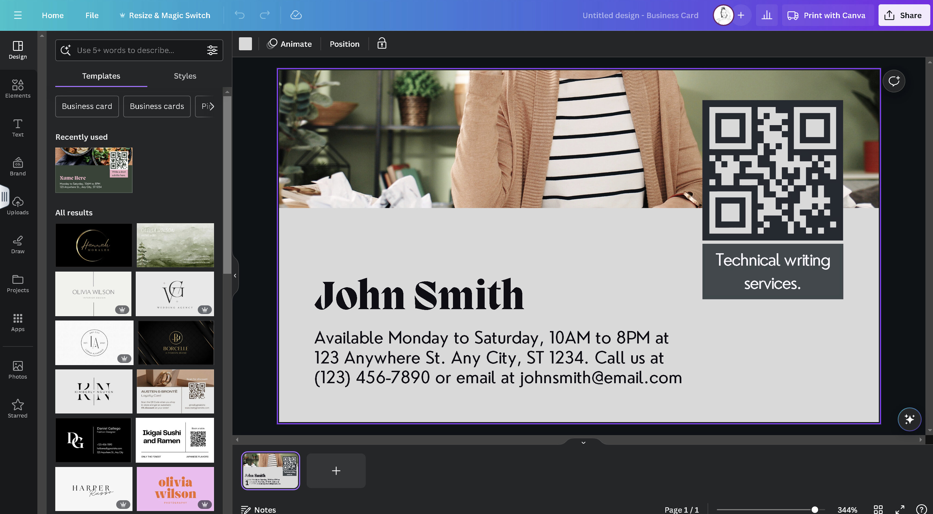
Use the design modifiers in the side panel to add personal touches and modify the look of your business card
Individual project layers and items can be selected and changed in the editing workspace

Slide 5
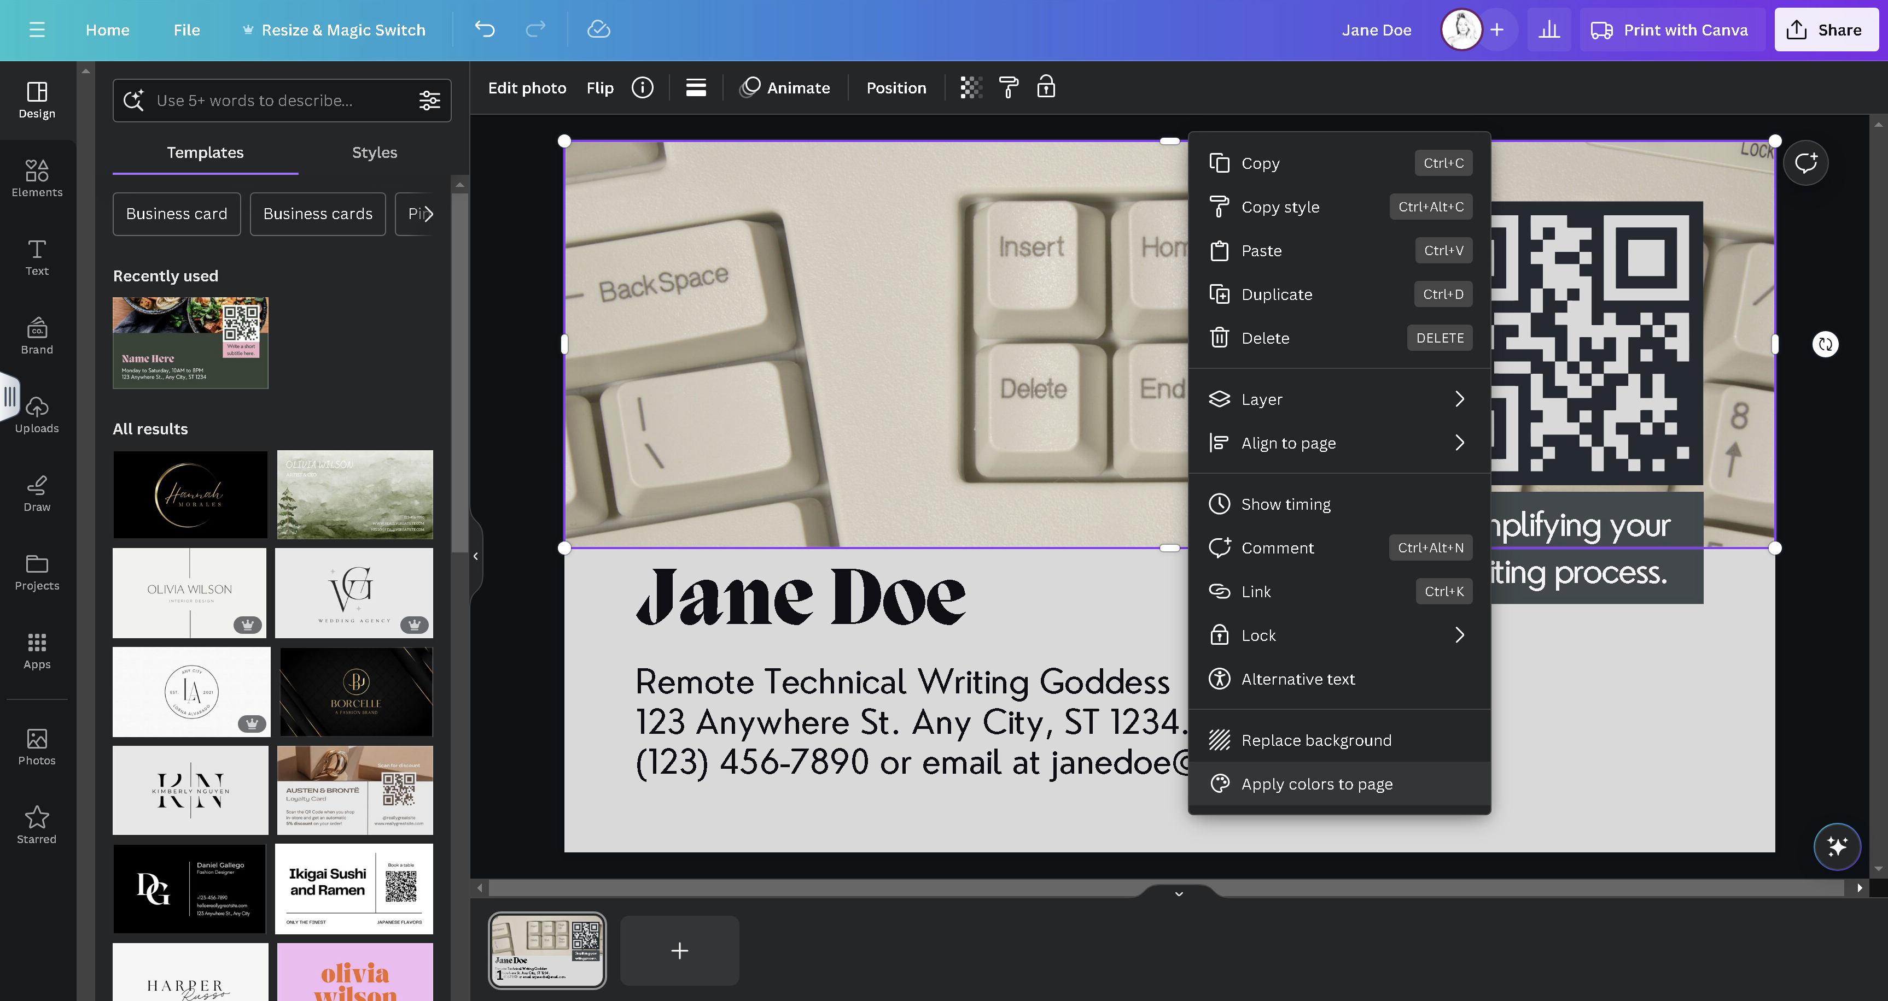
Visually synchronize an entire design with a custom embedded image:
Right click on the custom image and select Apply colors to page.

Slide 6
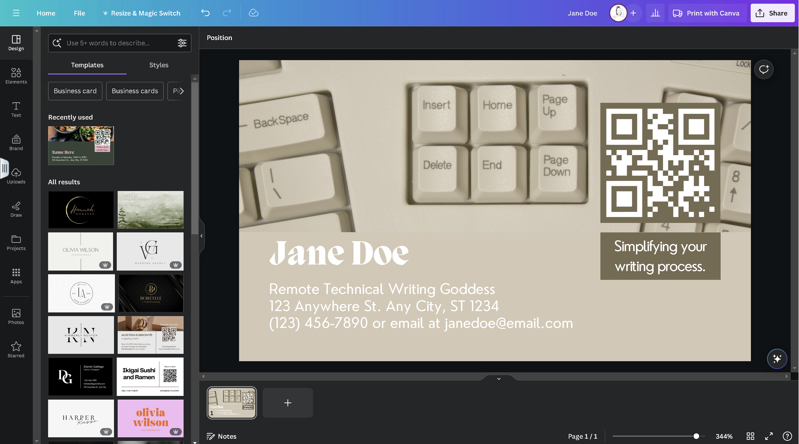
Add a reverse side to your card, design duplicates, or start designing a blank card

Slide 7
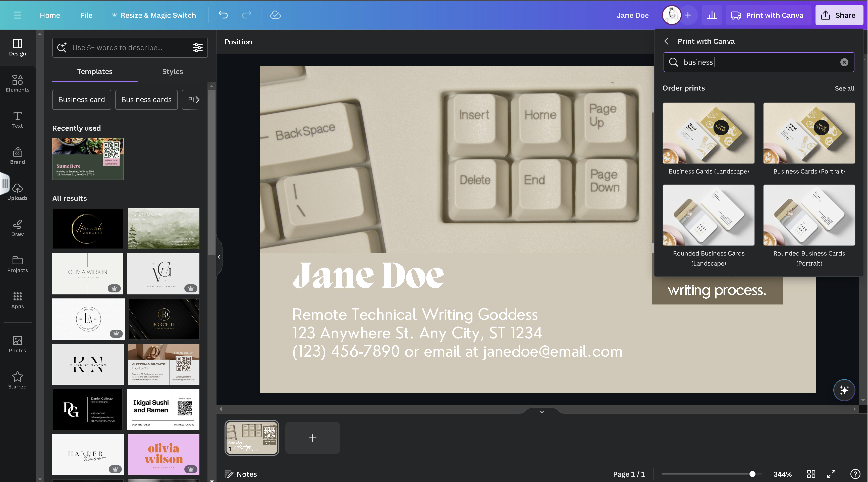
Export your business card for professional printing or save as a PDF to your computer

